Slide 1



Succeeding with Functional-First Languages in Industry
Dr. Don Syme
F# Community Contributor,
Principal Researcher, Microsoft
@dsyme

Slide 2
Today: Some Simple Observations About Data Engineering Data Pipelines Analytical Programming Game Server Engines Calculation Engines Coding … with F# (and associated technologies)

Slide 3
Let’s focus on the industry perspective and its correspondence to the technical features of F# Based on informal observations of many successful F# adoptions fsharp.org/testimonials also observations from OCaml, Scala, Erlang…

Slide 4
F# is free, open source, cross platform, independent fsharp.org

Slide 5
F# for Android http://fsharp.org/use/android

Slide 6
F# for iOS http://fsharp.org/use/ios

Slide 7
F# in Emacs https://github.com/fsharp/fsharpbinding/

Slide 8
Part 1
What’s the Situation? What’s the Problem?

Slide 9
I will use a standard methodology for communicating “complex” products.
S
P
Situation
Problem
I
Implication
N
Need
TM
“SPIN Selling”, Rackham

Slide 10
The Recurring Business Situation
“I lead a team developing…”
Data Processing Pipelines
Service Implementations
Trading Platforms
…
Insurance Calculation Engines
Market Simulators
Server-side Game Engines

Slide 11
The Recurring Business Situation
“I lead a team developing…”
Analytical Components
…
Analytical Components
Analytical Services
Analytical Components
Analytical Services

Slide 12
Understanding the Situation
Analytical Programmers/ Data Scientists
Design
Data Engineers
Code
Analysis
Algorithms
Parallel
Data
Information
Services
Presentation
Publication
UI

Slide 13
The Recurring Business Problems
Time to Market
Efficiency
Correctness
Complexity
for analytical components

Slide 14
Is Time to Market a Problem? Late Models → Missed market opportunities Late Services → Users have gone elsewhere Late Components → Millions evaporate
Financial model
Gaming service
Ad ranking engine
Notes:
“Take a moment to stop and think about the ramifications of time-to-market problems through software delays in analytical components for QF, FE, Trading and Calculation Engines more broadly”

Slide 15
Is Correctness a Problem? Buggy Models → Major risks to institutions Buggy Services → Users walk away Buggy Analytical Components → Millions leak away
Quant model
Gaming service
Ad ranking engine
Notes:
“Take a moment to stop and think about the ramifications of correctness problems through software delays in analytical components for QF, FE, Trading and Calculation Engines more broadly”

Slide 16
Is Efficiency a Problem? Slow Models → Can’t assess the institution daily Slow Services → Massive loss of online business Slow Analytical Components → Can’t scale to web
Financial model
Insurance quote service
Ad ranking engine
Notes:
“Take a moment to stop and think about the ramifications of efficiency problems through software delays in analytical components for QF, FE, Trading and Calculation Engines more broadly”

Slide 17
Is Complexity a Problem? Intractable Models → Can’t enter markets Intractable Services → Can’t deliver services Intractable Analytical Components → Can’t deliver
Notes:
“Take a moment to stop and think about the ramifications of efficiency problems through software delays in analytical components for QF, FE, Trading and Calculation Engines more broadly”

Slide 18
The Recurring Business Problems
Time to Market
Efficiency
Correctness
Complexity
for analytical components and services

Slide 19
What’s the Need? Analytical programmers delivering correct, efficient components in the enterprise, on-time This is one set of problems that functional-first programming helps solve

Slide 20
Part 2 - Why?
Observations and Examples

Slide 21
Observation #1
At the core of every functional-first language is this:
simple, correct, robust code for solving complex problems

Slide 22
Observation #2
A highly interoperable language allows rapid, non-intrusive deployment and integration of components
… functional-first code is a part of a larger solution. With F# your code can be rapidly integrated and deployed.

Slide 23
Observation #2 cont.
Interoperable languages remove entire phases from the analytical software development process.
…no R → C# …no Mathematica → C++ …no Excel → Java
Notes:
Functional programming tools empower when combined with other technologies

Slide 24
Observation #3
Strongly-typed functional-first languages maintain efficiency
…as good as C# and Java, and sometimes C++
Notes:
Functional programming tools empower when combined with other technologies

Slide 25
Observation #4
Strongly-typed functional languages help analytical programmers tackle more complex problems
…more time in the domain, less time on nulls and object hierarchies.
Notes:
Functional programming tools empower when combined with other technologies

Slide 26
Recap – How Functional-first Helps
Simple, correct, robust code
Interoperability eliminates entire phases
Strong-typing gives efficiency
Analytical developers empowered to solve complex problems

Slide 27
Example #1 (power company)
I have written an application to balance the national power generation schedule … for an energy company.
...the calculation engine was written in F#.
The use of F# to address the complexity at the heart of this application clearly demonstrates a sweet spot for the language … algorithmic analysis of large data sets.
Simon Cousins (Eon Powergen)

Slide 28
Example #1 (power company)
Time to Market
Efficiency
Interoperation ... Seamless. The C# programmer need never know.
Units of measure … a huge time saver...it eradicates a whole class of errors…
Exploratory programming …Working with F# Interactive allowed me to explore the solution space more effectively.
Unit testing …a joy to test. There are no complex time-dependent interactions to screw things up….
Parallelism …The functional purity ... makes it ripe for exploiting the inherent parallelism in processing vectors of data.
Code reduction… … vectors and matrices…higher order functions eat these for breakfast with minimal fuss, minimal code. Beautiful.
Lack of bugs… Functional programming can feel strange. .. once the type checker is satisfied that’s often it, it works.
Correctness
Time to Market
Time to Market
Correctness
Correctness

Slide 29
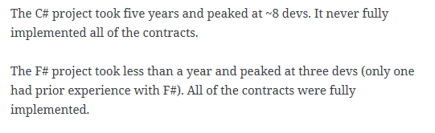
A related analysis (Simon Cousins, Energy Sector)
350,000
lines of C# OO
by offshore team
30,000
lines of robust F#, with
parallel +more features
An application to evaluate the revenue due from Balancing Services contracts in the UK energy industry
http://simontcousins.azurewebsites.net/does-the-language-you-use-make-a-difference-revisited/

Slide 30
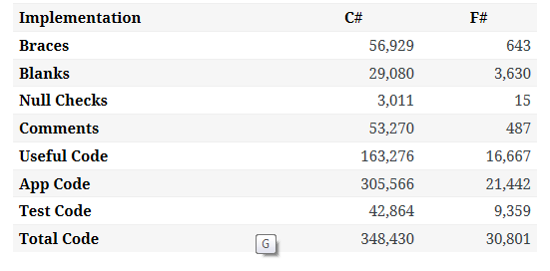

Slide 31
A related analysis (Simon Cousins, Energy Sector)
Zero
bugs in deployed system
“F# is the safe choice for this project,
any other choice is too risky”
An application to evaluate the revenue due from Balancing Services contracts in the UK energy industry
http://simontcousins.azurewebsites.net/does-the-language-you-use-make-a-difference-revisited/

Slide 32
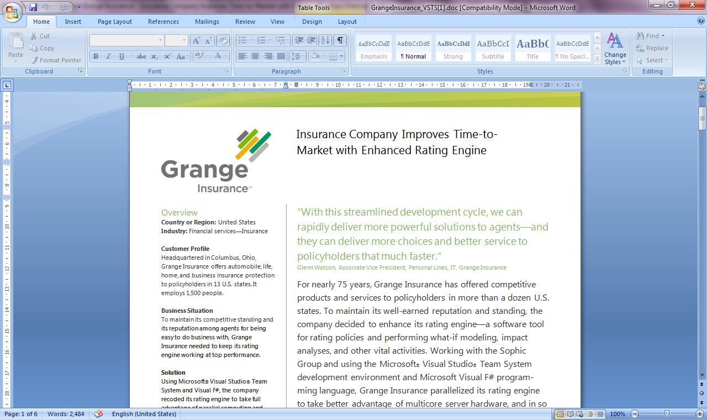
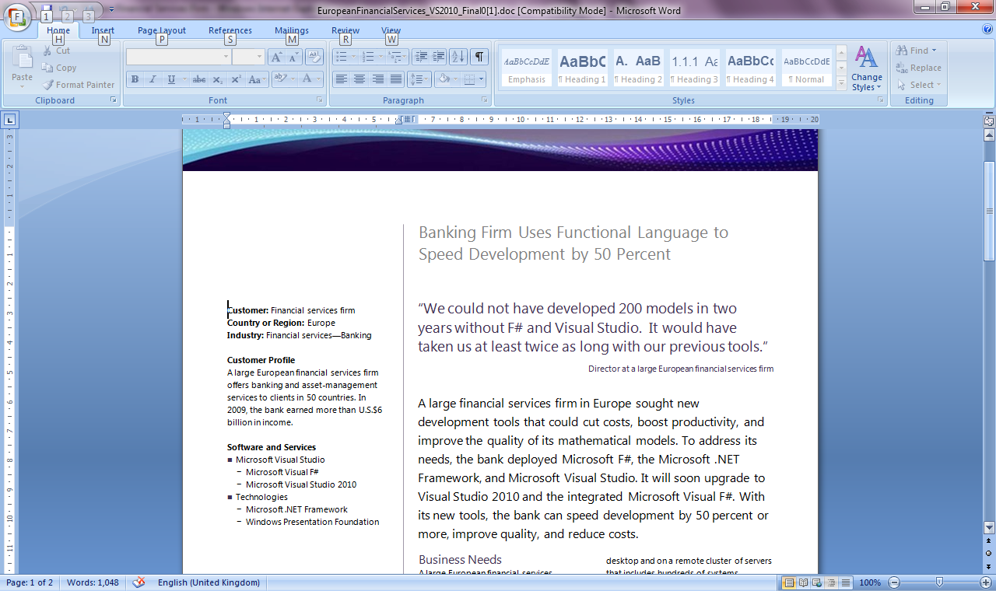
Example #2: F# in Finance
Time to Market
Correctness
Time to Market
Correctness
Efficiency
http://fsharp.net

Slide 33
Example #3: F# in Insurance
Time to Market
Complexity
I work for a large actuarial company... …Despite adopting Agile/Scrum …the usual delays, complications and sometimes …failures.
We used F#, and quickly created a system which would perform the necessary calculations highly efficiently, in parallel, and with a perfect match to the spreadsheet results.
All of the advantages which are commonly touted for F# do play out in practice. Immutability, Easy Parallelisation, Expressiveness, Testability, Conciseness, Flexibility, Productivity
[ Company name omitted ]
Efficiency
Correctness
fsharp.org/testimonials

Slide 34

Example #4: Finance trading platform
F# + C# for Trading Front End
Leverage F#’s features:
- extensive type system
- asynchronous workflows, agents and immutable types
- rich pattern matching and parser support
“Experienced F# developers regularly solve problems in days that would take weeks using more traditional languages…solving complex problems in an elegant and highly maintainable manner”
Phil Trelford, Trading Platform Company
Time to Market
Complexity

Slide 35
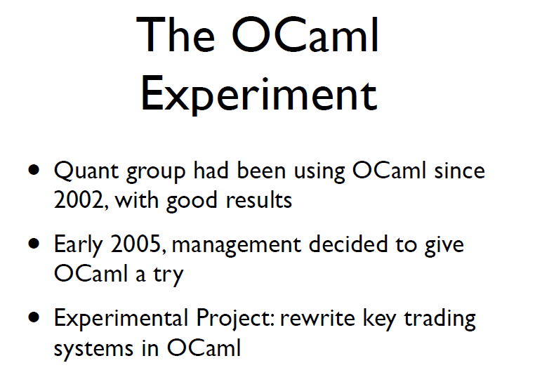
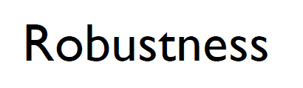
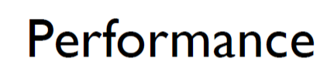
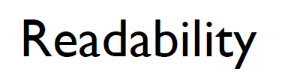
Example #5: OCaml @ Jane St
source: http://www.janestcapital.com/yaron_minsky-cufp_2006.pdf

Slide 36
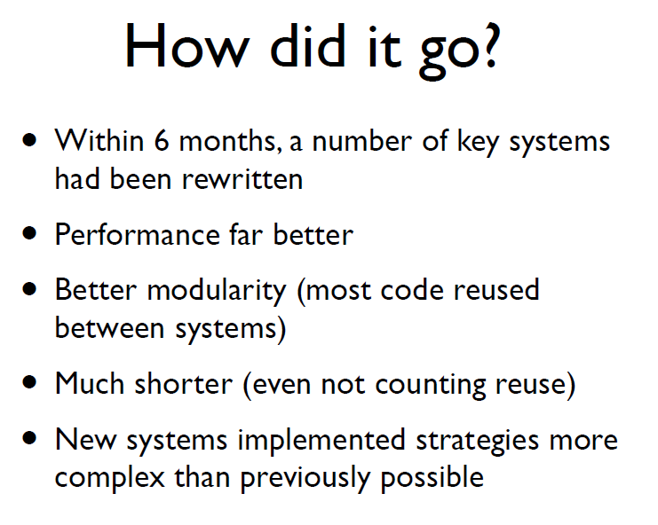
Example #5: OCaml @ Jane St
Efficiency
Solve complex problems
source: http://www.janestcapital.com/yaron_minsky-cufp_2006.pdf

Slide 37
Example #6: F# in Biotech
Efficiency
...F# rocks - building algorithms for DNA processing and it's like a drug. 12-15 at Amyris use F#... A complete genome resequencing pipeline with interface, algs, reporting in ~5K lines and it has been incredibly reliable, fast and easy to maintain.. A suffix tree in 150 lines that can index 200,000 bases a second
F# v. Python: F# has been phenomenally useful. I would be writing a lot of this in Python otherwise and F# is more robust, 20x - 100x faster to run and faster to develop.
Darren Platt, Amyris BioTechnologies
Correctness
Time to Market

Slide 38
Example #7: F# in Advertisement Ranking & Rating @ Microsoft
Time to Market
Around 95% of the code in these projects has been developed in F#.
F# allowed for rapid development of prototypes, and thus also rapid verification or falsification of the underlying mathematical models.
Complex algorithms, for example to compute Nash equilibria in game theory, can be expressed succinctly.
Units of measure reduced the chance of errors dramatically: Prices, probabilities, derivatives, etc. can already be kept apart at compile time.
Taming Complexity
Correctness

Slide 39
Example #8: F# at Kaggle
Taming
Complexity
At Kaggle we initially chose F# for our core data analysis algorithms because of its expressiveness.
We’ve found ourselves moving more and more of our application …into F#. The F# code is shorter, easier to read, easier to refactor, and, because of the strong typing, contains far fewer bugs.
As our data analysis tools have developed, we’ve seen domain-specific constructs emerge very naturally. As our codebase gets larger, we become more productive.
Correctness
Time to Market
fsharp.org/testimonials

Slide 40
Example #9: F# for Machine Learning at Microsoft
I wrote the first prototype of the click prediction system deployed in Microsoft AdCenter in F# in a few days.
For a machine learning scientist, speed of experimentation is the critical factor to optimize.
Unlike C# and C++, F# was designed for this mode of interaction. Switching to F# was liberating and exhilarating.
The world is moving toward functional programming with good justifications: the code is cleaner and easier to debug in a distributed environment.
Time to Insight
Correctness
Dr. Patrice Simard, Microsoft Distinguished Engineer, fsharp.org/testimonials

Slide 41
Example #10: F# for Consulting
Correctness
Efficiency
Our bids for tendered contracts in quantitative finance are regularly half the price of competitors because of the increased productivity we get from F#.
We are regularly able to deliver correct, robust, performant solutions on-time, which is what our customers value most.
Daniel Egloff, QuantAlea Consulting, Zurich
Time to Market
http://fsharp.org/testimonials

Slide 42
Example #11: F# for Social Gaming
Efficiency
F# is becoming an increasingly important part of our server side infrastructure that supports our mobile and web-based social games with millions of active users. F# first came to prominence in our technology stack in the implementation of the rules engine for our social slots games which by now serve over 700,000 unique players and 150,000,000 requests per day at peaks of several thousand requests per second.
The F# solution offers us an order of magnitude increase in productivity and allows one developer to perform the work that are performed by a team of dedicated developers on an existing Java-based solution, and is critical in supporting our agile approach and bi-weekly release cycles.
Yan Cui, Lead Server Engineer
Time to Market
http://fsharp.org/testimonials

Slide 43
Example #12: F# for Insurance
Efficiency
One of the world’s largest insurance companies have F# code in production, are starting several more projects in F#.
They migrated some of their number crunching and business logic to F# and are so happy with the results (10x faster and 10x less code vs their Visual C++ 6) that they are proposing to migrate 1,600,000 lines of code to F#. In particular, their developers found F# easy to learn and use.
… my predecessor developed an entire pension quote calculator (typically scheduled to take 300-400 man days) entirely in F# in under 100 days with no prior F# experience at all. Performance is 10× better than the C++ that it replaces because the new code avoids unnecessary copying and exploits multicore parallelism.
Aviva
Time to Market
http://fsharp.org/testimonials

Slide 44
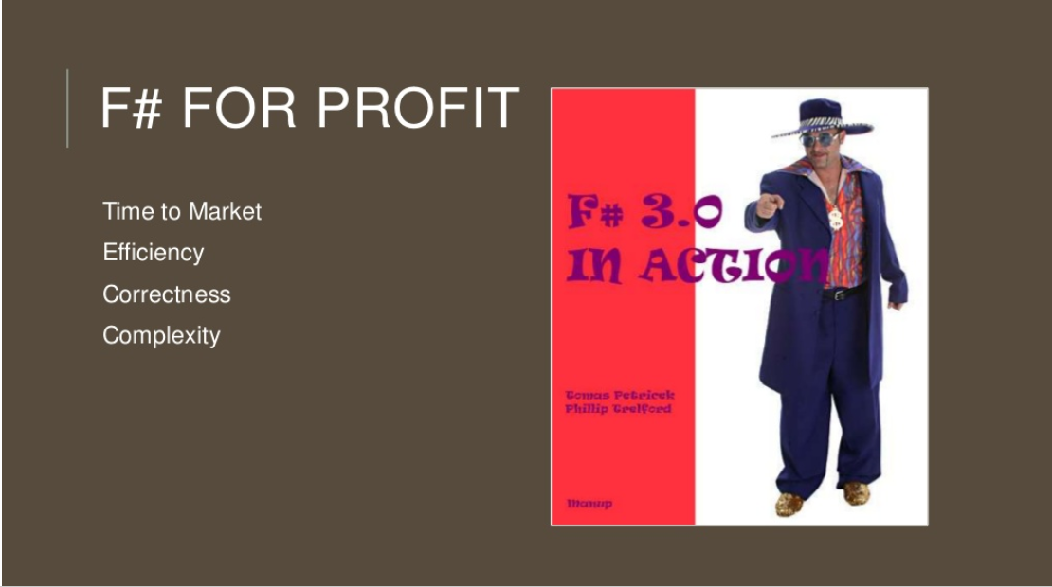

Slide 45
Summary – The Data Agrees
Simple, correct, robust code
Interoperability improves time-to-market
Strong-typing gives efficiency
Analytical developers empowered to solve complex problems

Slide 46
Part 3 – Topics on F# in Practice

Slide 47
Part 3 – Topics on F# in Practice
Topic - Data

Slide 48
You can easily find out more about…
F# Basics
F# for Cloud Data
F# for DSLs
F# for GPUs
F# for Pricing
F# + R
F# for Data Science
F# + Excel
F# Deep Data Integration

Slide 49
Proposition 1 The world is information-rich

Slide 50
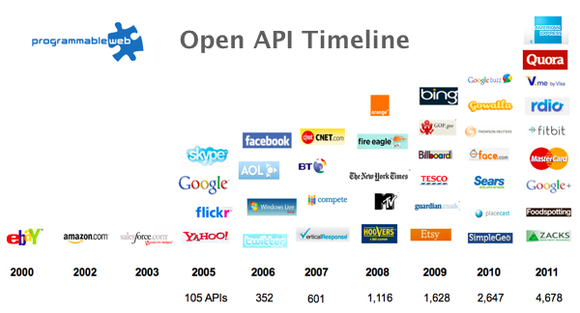
The Information Revolution
2012
2013
6,432
10,537

Slide 51

Data is like water…

Slide 52
Data is like water…
Everyone needs it. Everyone knows where to get it.
Nobody is sure where it really came from, or goes to.
…really knows its true cost, or true value.
…likes to pay for it, or to share it.
…knows how much is wasted.
You might get washed away by it.
You only find out it was bad after you have drunk it.

Slide 53

Actually these days it’s more like a flood…

Slide 54
The Problem Our programming tools are data-sparse getting data into a programming language is tiresome, error prone and boring

Slide 55
We need to bring data into the language… At internet scale, strongly tooled, strongly typed

Slide 56
Problem: Integrate all of freebase.com “as if it were a library” >40M entities, >1Billion facts, >24,000 types, >65,000 properties

Slide 57
Demo
F# + Freebase
An F# type provider for deep, robust integration of web data

Slide 58

All your types are belong to us….
types

Slide 59
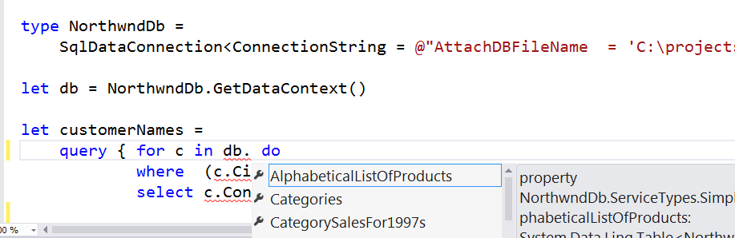
SQL #1

Slide 60
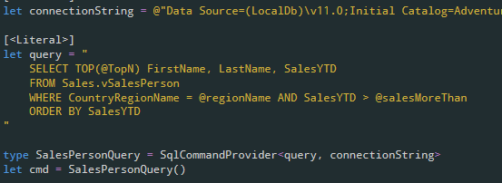
SQL #2

Slide 61
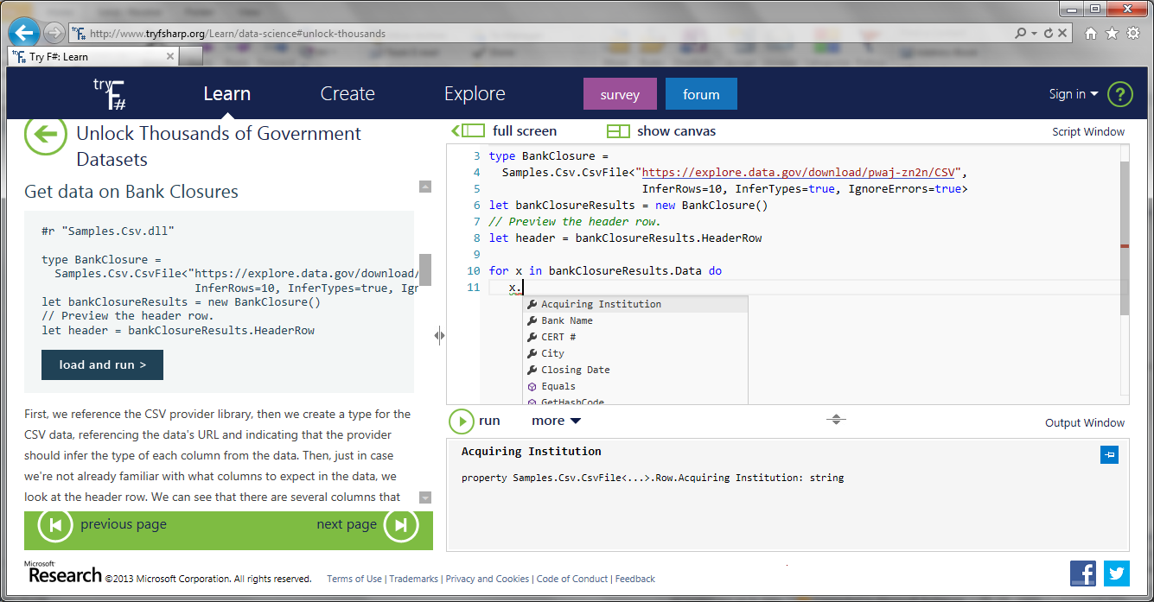
CSV

Slide 62
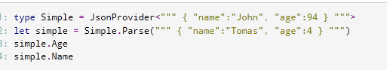
JSON

Slide 63
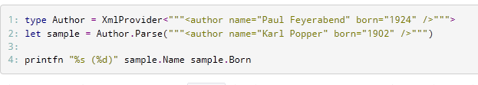
XML

Slide 64
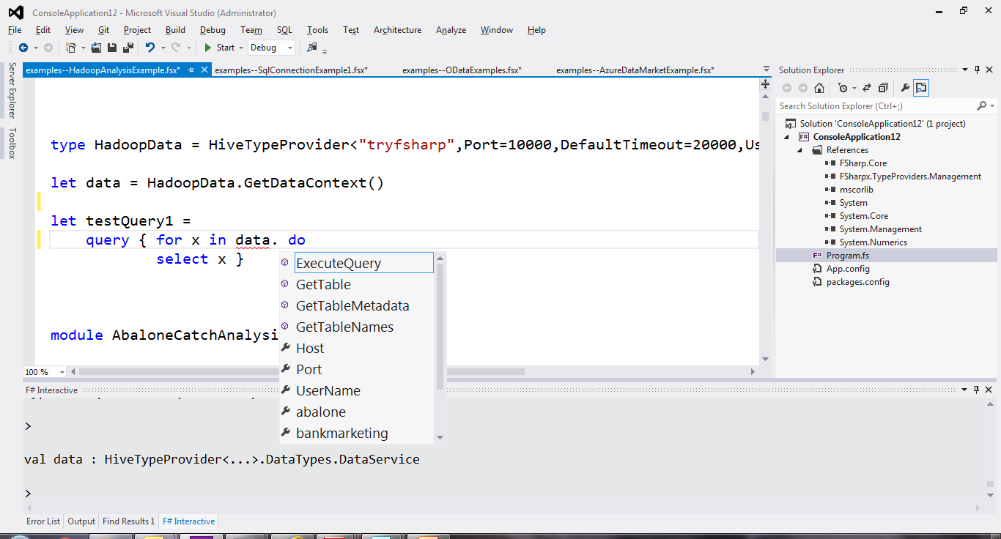
Hadoop/Hive

Slide 65
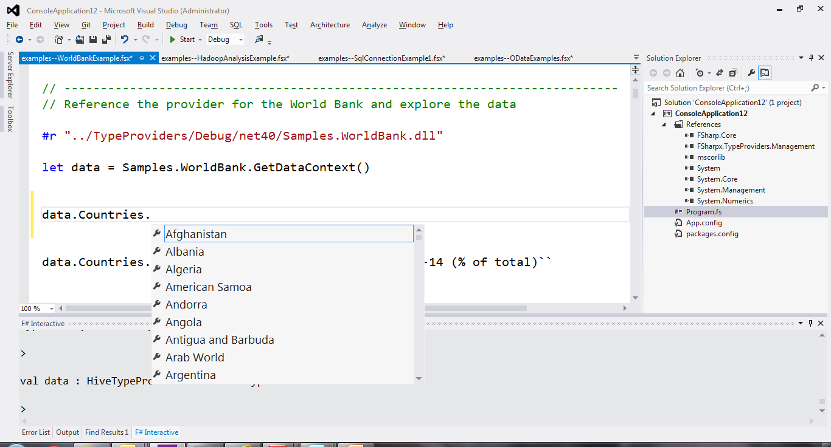
World Bank

Slide 66
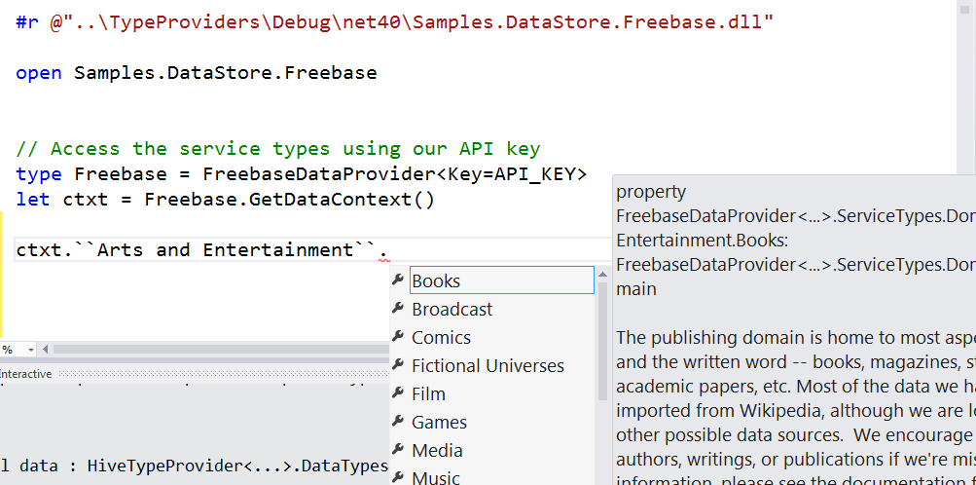
Freebase

Slide 67
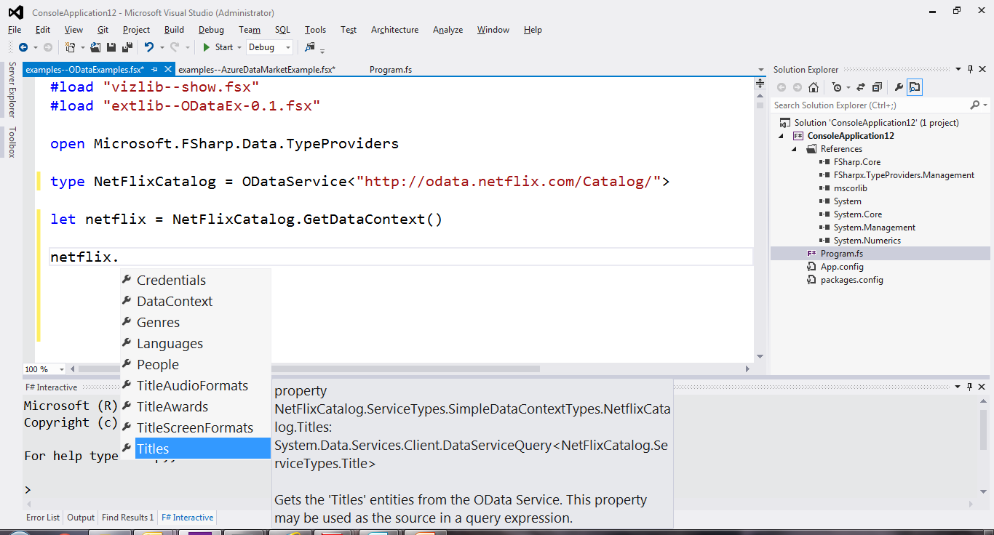
OData

Slide 68
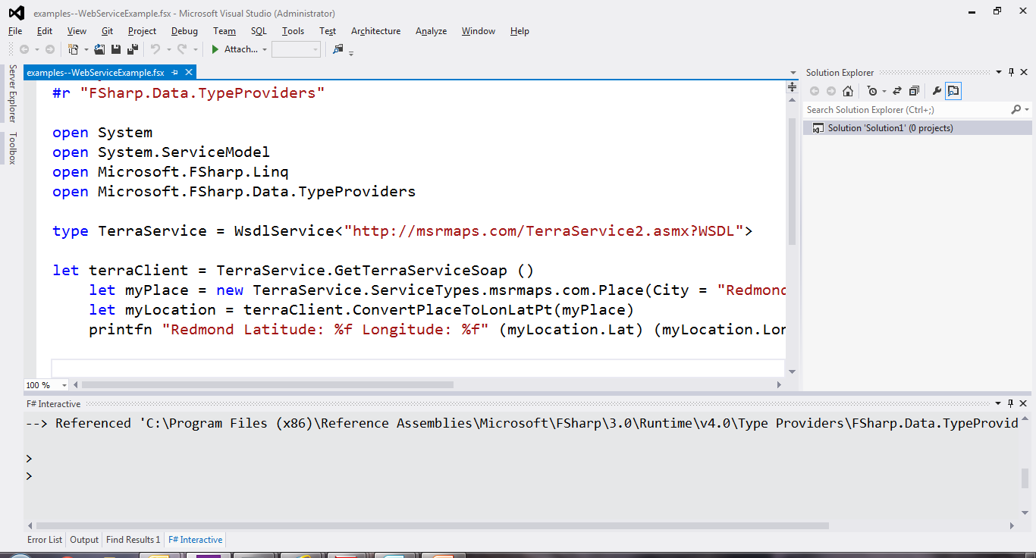
WSDL

Slide 69
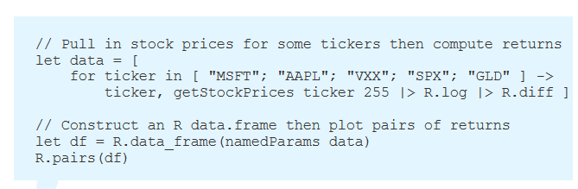
R

Slide 70
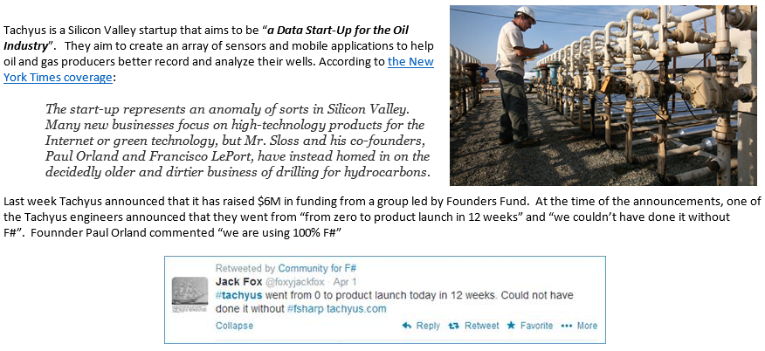
SQL #2 - Application
Correctness
Time to Market

Slide 71
Part 3 – Topics on F# in Practice
Topic – Managing Complexity in the Large

Slide 72
The dependency structure of some real-world OO and functional-first projects

Slide 73
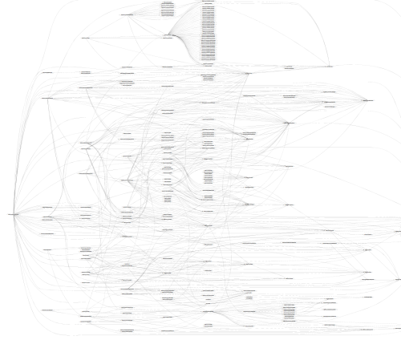
SpecFlow (C#)

Slide 74
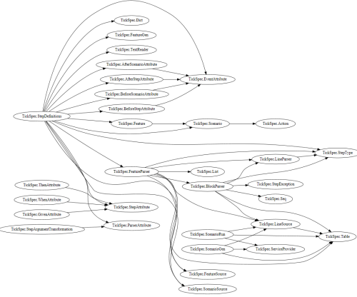
TickFlow (F#)

Slide 75
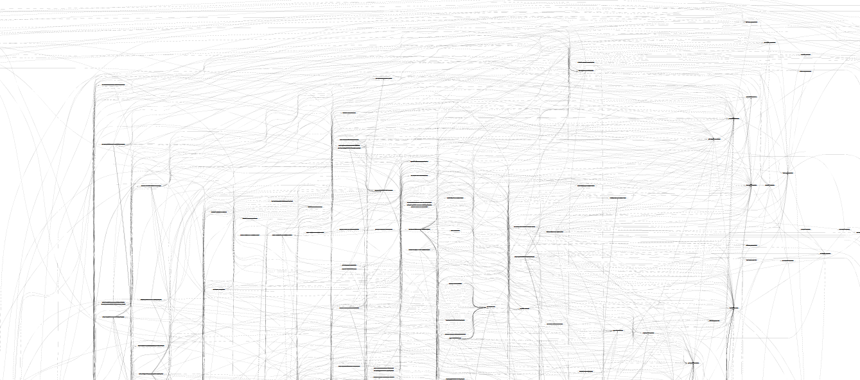
“Entity Framework” (OO)
TickFlow

Slide 76
(and that’s just 1/4 of the graph…)

Slide 77
Part 3 – Topics on F# in Practice
Topic – Integration

Slide 78
Typical F# Topics
F# Basics
F# + Excel
F# for DSLs
F# for GPUs
F# for Pricing
F# + R
F# for Data Science
F# Deep Data Integration

Slide 79
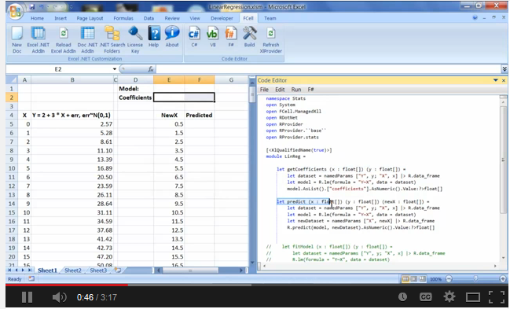
Functional + R + Excel Integration via fcell.io

Slide 80
Part 3 – Topics on F# in Practice
Topic – GPU Execution

Slide 81
Typical F# Topics
F# Basics
F# + Excel
F# for DSLs
F# for GPUs
F# for Pricing
F# + R
F# for Data Science
F# Deep Data Integration

Slide 82

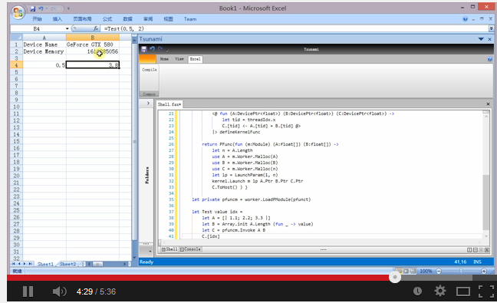
Functional + GPGPU
F# + FCell +

Slide 83
Summary

Slide 84
Functional-first programming is the safe choice for many programming tasks in industry

Slide 85
Training, learning and community are key!

Slide 86
Summary – F#
F#
The safe choice for functional-first
Unbeatable, practical, scalable data integration
Tooling for Windows, Linux, OSX, Android, iOS and more
Open, cross-platform, strongly typed, efficient, rock-solid stable

Slide 87
To find out more…
Learn F# at tryfsharp.org (including financial)
Lots of resources at fsharp.org
Join the Copenhagen Functional Meetup Group!
Testimonials at fsharp.org/testimonials
Over 100 videos at fsharp.org/videos

Slide 88

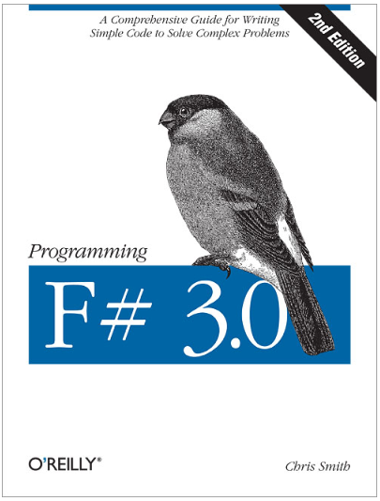
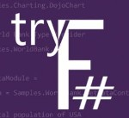
Questions?
tryfsharp.org

Slide 89
How the Visual F# Tools help Microsoft
Code-oriented tooling for a modern, smart, data-rich company
Open yet highly aligned with our primary profitable platforms
An aligned option for 10,000s adopting Scala, Clojure
A vibrant, open, community-based approach
Direct VS sales and pull-through with major financials and others
Significant intangibles as well (happy productive customers among them)

Slide 90
"Functional-first programming is a general-purpose programming technique particularly suited to tasks where Time-to-deployment, Efficiency, Correctness and Taming Complexity dominate."

Slide 91
"Examples include ETL pipelines, general data-manipulation, service implementation, calculation engines, programmatic UIs and data science. While these problems can be solved using other programming paradigms, they are particularly amenable to functional-first programming."

Slide 92
"Functional-first programming uses functional programming as the initial paradigm for most purposes, but employs other techniques such as objects and state as necessary."

